Slide 1

SUMMER SALE 2026
Guide: How to set up your 2026 summer sale on Kiabi?
Even more for families

Slide 2

<<< Back to the contents
HOW TO USE THIS FAQ
Contents
Key information
I’m selling in just one country
1
2
Calendar by country, how to take part, and guidance on which section applies to you.
Only one channel activated (France). The 4 fields to fill in, as for the winter sales.
I sell in several countries
Pitfalls, tools & support
3
4
At least 2 channels activated. The fields specific to each channel and a concrete example.
Overrides, stock levels, drop-shipping offers, Omnibus, Mirakl Connect and support contact.
More and more for families

Slide 3


<<< Back to the contents
PART 1 · THE ESSENTIALS YOU NEED TO KNOW
Sales calendar by country
Key point: sale dates vary from country to country. This is precisely what determines how you set up your offers (see the guide on the next slide).
Country​ | Channel | Start of sales | End of sales
France*​ | 100​ | 06/24/2026 | 07/21/2026
Spain​ | 200​ | 06/19/2026​ | 08/02/2026
Italy​ | 300​ | 07/04/2026​ | 09/01/2026
Belgium​ | 400​ | 07/01/2026 | 07/31/2026
Portugal​ | 800​ | 06/19/2026​ | 08/16/2026
*Only in France is the site ‘frozen’ until 8.00 am on the day. In the other four countries, sale offers are visible from midnight.
More and more for families

Slide 4


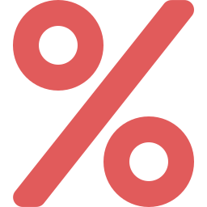

<<< Back to the contents
PART 1 · THE ESSENTIALS YOU NEED TO KNOW
How do I take part in the sales?
To take part in the sales on the Kiabi marketplace, there are 3 requirements to meet:
1
Confirm your participation
Contact your Kiabi account manager and provide them with the list of relevant EANs (using the Excel spreadsheet provided) — by 10 June 2026 at the latest.
2
Offer a discount of ≥ 5%
If the discount is less than 5%, your products will remain online but will not feature the ‘Sale’ sticker or be highlighted in the dedicated showcase.
3
Set up your sale offers
Enter your discounted prices and dates in your offer feeds (see Part 2 or Part 3 as applicable).
⚠ Please note: after 10 June, we cannot guarantee that your products will appear in the sale showcase at launch, nor that they will feature the ‘Sale’ sticker.
More and more for families

Slide 5



<<< Back to the contents
PART 1 · THE ESSENTIALS YOU NEED TO KNOW
Which section applies to me?
First and foremost, identify your situation. The number of active channels (countries) on your Mirakl account affects how you set up your balances.
SECTION A
SECTION B
I sell on ONE channel
I sell on 2 or more CHANNELS
In practice: you only have the France channel (100) active.
In practice: France + at least one other country (ES, IT, BE, PT).
You fill in the 4 standard fields (as for the winter sales, only the dates change).
You must fill in the context-specific fields for each channel — without forgetting the default price.
→ Read section 2 carefully.
→ Read Part 3 carefully
More and more for families

Slide 6
<<< Back to the contents
PART 2 · I SELL IN A SINGLE COUNTRY
A1 · The 4 fields to fill in
Do you only sell in France? The process is the same as for the winter sales: only the dates change. Fill in these 4 fields in your product feed.
The crossed-out price (original price), before discount.
price
E.g. €20.00
The discounted price that applies during the sales.
discount-price
E.g. €15.00
The start date of the sales in France.
discount-start-date
24 June 2026
The end date of the sales in France.
discount-end-date
21 July 2026
No need to specify a time: Mirakl automatically sets 00:00 (start) and 23:59 (end). See next slide.
More and more for families

Slide 7


<<< Back to the contents
PART 2 · I SELL IN A SINGLE COUNTRY
A2 · Do I need to specify a time?
No. Just specify the dates. When given 2026-06-24 (start) and 2026-07-21 (end), Mirakl automatically sets the start time to midnight sharp and the end time to 23:59.
The ‘freeze’ of the Kiabi France website
On the day, the France site is frozen between midnight and 8.00 am: no orders can be placed before 8.00 am, in accordance with French regulations. Your sale offers are therefore visible from 8.00 am — there is no need to specify a time.
If you still wish to specify a time:
discount-start-date: 2026-06-24T00:00:00+02
discount-end-date: 2026-07-21T23:59:59+02
More and more for families

Slide 8

<<< Back to the contents
PART 3 · I SELL IN SEVERAL COUNTRIES
B1 · The multi-channel principle
As soon as you sell on two or more channels, you can no longer make do with the default price fields.
Why?
Sales dates vary from country to country. You are therefore obliged to use discount dates specific to each channel (discount-start-date[channel=…]). And automatically, you must also enter prices for each channel.
For EVERY channel on which you sell, enter:
price[channel=…]
discount-price[channel=…]
discount-start-date[channel=…]
discount-end-date[channel=…]
Don’t forget: the default ‘price’ field remains mandatory (see B4), otherwise Mirakl will reject the offer.
More and more for families

Slide 9

<<< Back to the contents
PART 3 · I SELL IN SEVERAL COUNTRIES
B2 · Channel mapping
Each country corresponds to a channel number. Here are the price fields to use for each:
 | France | Spain | Italy | Belgium | Portugal
Channel | 100 | 200 | 300 | 400 | 800
price[channel=] | 100 | 200 | 300 | 400 | 800
discount-price[channel=] | 100 | 200 | 300 | 400 | 800
discount-start-date[channel=] | 100 | 200 | 300 | 400 | 800
discount-end-date[channel=] | 100 | 200 | 300 | 400 | 800
You only need to fill in the columns for the countries where you actually sell. The left-hand column shows the base name of the field, to be completed with the channel number.
More and more for families

Slide 10



<<< Back to the contents
PART 3 · I SELL IN SEVERAL COUNTRIES
B3 · Practical example of configuration
Example: you sell a product in France, Spain and Italy. Discount of €12 (FR), €15 (ES) and €15 (IT).
# Default price — MANDATORY (otherwise rejected by Mirakl)
price = €20
# France channel (100)
price[channel=100] = €20 discount-price[channel=100] = €12
discount-start-date[channel=100] = 2026-06-24 discount-end-date[channel=100] = 2026-07-21
# Canal Spain (200)
price[channel=200] = €20 discount-price[channel=200] = €15
discount-start-date[channel=200] = 4 July 2026 discount-end-date[channel=200] = 23 August 2026
# Italy Channel (300)
price[channel=300] = €20 discount-price[channel=300] = €15
discount-start-date[channel=300] = 2026-07-04 discount-end-date[channel=300] = 2026-08-23
Note the different dates by country (FR vs ES/IT): this is why the channel-specific fields are essential. The same applies to Belgium (400) and Portugal (800).
If you sell in several countries but only wish to participate in the sales in some of them, simply enter the full prices in the price fields specific to the relevant channels
More and more for families

Slide 11


<<< Back to the contents
PART 3 · I SELL IN SEVERAL COUNTRIES
B4 · The default price remains mandatory
Even if you set different prices for each channel, you must ALWAYS fill in the default ‘price’ field.
This is a mandatory field for Mirakl. Its value will be overridden by channel-specific prices anyway — but without it, your offers will be flagged as errors.
If the ‘price’ field is empty, your offers will appear as errors in Mirakl’s offer error reports, with the reason:
The 'price' field is mandatory
Recommended best practice
Outside of sales periods, even if your prices are identical across all channels, always fill in the channel-specific price fields by duplicating the information during your mapping. This will minimise the risk of errors when configuring sales.
More and more for families

Slide 12

<<< Back to the contents
PART 4 · PITFALLS, TOOLS & SUPPORT
Don’t overshadow your sale offers
Pitfall No. 1: pushing a non-discounted feed over a discounted offer.
For the same SKU offer, if you first push an offer with a discounted price and then a feed with a non-discounted price, the previous data is overwritten: your product is no longer on sale.
✓ What to do
✗ What breaks the discount
Continue to populate discount-price, discount-start-date and discount-end-date in all your feeds during the sale period.
Pushing a feed that contains only the full price (without the discount fields) for an SKU that is already on sale: the discount disappears immediately.
More and more for families

Slide 13

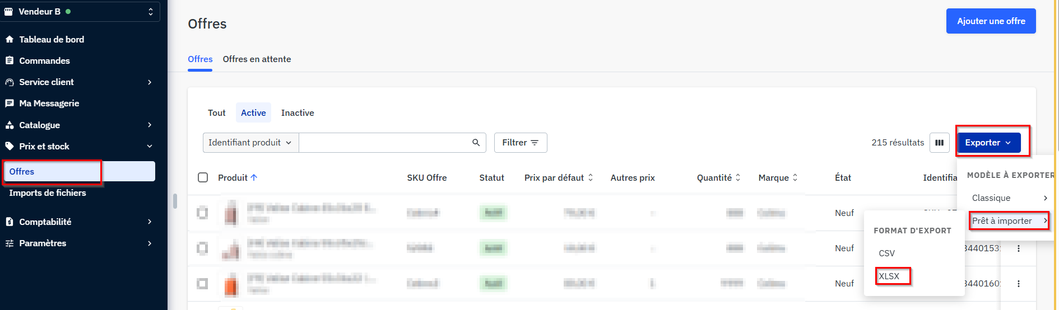
<<< Back to the contents
PART 4 · PITFALLS, TOOLS & SUPPORT
Check that your offers have been successfully uploaded
To check that your sale offers are correctly reflected on Mirakl:
1
“Offer” section of the Kiabi back office on Mirakl: https://kiabi.mirakl.net/mmp/shop/offer
2
Export to Excel (XLSX) — Using the Export button, as shown in the screenshot below.
3
Check that the columns relating to discounted prices and start/end dates are fully completed.
Exporting offers from the Mirakl back office:
More and more for families

Slide 14

<<< Back to the contents
PART 4 · PITFALLS, TOOLS & SUPPORT
Do I need bridge offers?
No, you shouldn’t need to push relay offers. The return to the full price is automatic. Let’s take a specific example from France:
1
1 April
You place your first offer on product X at €30 (without specifying a start or end date). The product remains available at €30 as long as stock is greater than 0 (an offer with no time limit, known as a ‘stock-based offer’).
2
10 June
You decide to include this product in the sale at €20 (via the discount-price field). You push an offer feed with a start date of 2026-06-24 and an end date of 2026-07-21.
3
On the day
Until 23 June at 23:59, the product remains at €30; it drops to €20 the following day, the start of the sale. At the end of the sale, it automatically reverts to €30 (the default offer takes over).
In summary: if you launch a sale offer after sending an undated offer, the undated offer automatically takes over the day after the sale ends. For multi-channel sales, the principle is the same: each country reverts to its base price at the end of ITS own sale period.
More and more for families

Slide 15

<<< Back to the contents
PART 4 · PITFALLS, TOOLS & SUPPORT
Applying multiple markdowns
Do you want to increase the discount during the sales (2nd, 3rd price drop)? It’s simple.
The rule: only change the discount price on the day of the new markdown, keeping the same start and end dates for the discount.
Example for France:
1st markdown
from 24/06 to 07/07
discount-price = price at −30%
30% off
2nd markdown
from 8 July to 21 July
We just change the discount price (dates remain the same)
40% off
More and more for families

Slide 16


<<< Back to the contents
PART 4 · TRAPS, TOOLS & SUPPORT
Stock management
Important: stock (the ‘quantity’ field) is unique and shared — across all channels and the stock pool / discounted stock.
For a given EAN, you cannot specify 50 for France and 0 for Italy. The same quantity applies to all active channels on your account.
How to change stock without affecting your balances:
Option 1
Continue to populate the discount fields
Update your stock levels as usual, whilst retaining the discount-price, discount-start-date and discount-end-date fields in the feed.
Option 2
Push an SKU + Quantity feed only
A feed containing only the SKU and quantity updates the stock alone, without overwriting the discounted offer.
More and more for families

Slide 17



<<< Back to the contents
PART 4 · PITFALLS, TOOLS & SUPPORT
Strikethrough prices & the Omnibus Directive
You are not entirely free to set the crossed-out price (reference price) that you display. Regulations govern this practice.
The 30-day rule
The previous price (the crossed-out price) must be the lowest price charged by the seller during the 30 days preceding the start of the promotional period.
Products that do not comply with this rule will not be eligible for the ‘Sale’ sticker or inclusion in the dedicated display.
Reference: Omnibus Directive — legifrance.gouv.fr (article LEGIARTI000044549592)
More and more for families

Slide 18

<<< Back to the contents
PART 4 · PITFALLS, TOOLS & SUPPORT
Integrator, back office or Mirakl Connect?
Depending on how you manage your offers, here’s what to do:
I use an integrator
All integrators have received a communication detailing our expectations for the sales. If you have any issues, please open a ticket with your integrator — we cannot act on your behalf.
I’m using the Mirakl back office
Download the offer template from your back office, fill it in with your sale offers and upload it. The video below (Vimeo link) explains this method step by step.
I’m using Mirakl Connect
To our knowledge, the module does not support discount dates: you must disable price synchronisation before pushing your sale offers. → See the next slide (detailed screenshot).
▶
Explanatory video to watch first
Essential for manual uploads via the back office, and recommended for Mirakl Connect: https://vimeo.com/1194359144/371b152df1
More and more for families

Slide 19
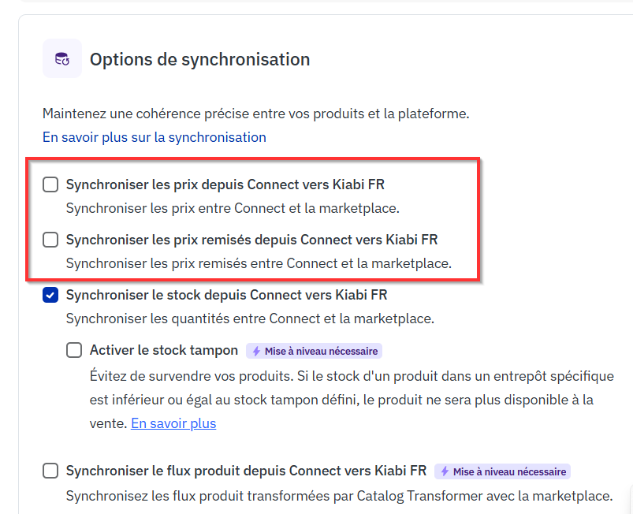
<<< Back to the contents
PART 4 · PITFALLS, TOOLS & SUPPORT
Focus: setting up sales via Mirakl Connect
Important: To our knowledge, the Mirakl Connect module does not allow you to manage discount dates. Before manually pushing your sale offers, you must disable price synchronisation.
1
Uncheck the 2 ‘price’ boxes
Synchronise prices + Synchronise discounted prices (highlighted in red opposite).
2
Keep stock synchronised
NEVER change the stock synchronisation settings: they must remain enabled.
3
Upload your sale offers
Manually in your Kiabi Mirakl back office, with your discounted prices and dates.
4
Reactivate after the sales
Re-enable price synchronisation once the sales have ended.
Synchronisation options — Mirakl Connect
More and more for families

Slide 20

<<< Back to the contents
PART 4 · PITFALLS, TOOLS & SUPPORT
My sale offers aren’t showing up
Have you followed the recommendations but can’t see your sale offers in Mirakl? Here’s what to do.
Check your offer error reports
In Mirakl (or via your integrator). This is the first step to understanding why an offer hasn’t been displayed.
Products with the status ‘modifications required’
Your products must be corrected and validated by us before they can be listed.
Products awaiting approval?
Open a support ticket (reason: validation of new products) via our contact form.
Contact form: https://kiabimarketplace.my.site.com/servicemarketplace/s/
More and more for families

Slide 21
Any questions?
If you have any questions, please contact our support team by submitting a ticket via our enquiry form:
https://kiabimarketplace.my.site.com/servicemarketplace/s/
More and more for families

